Slide 1
Version 2007
3D milling
Notes:
Today we are going to talk about the 3D milling package from FC.
Some of the 3D technology has been improved in this release, allowing for better handling of 3D files.
***For the whole 3D demo we will use the file named ‘spiral test cases.fm’ Open this file in FC because we will use it throughout the ppt.***

Slide 2

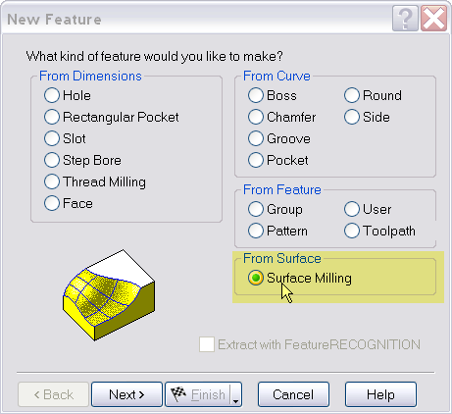
3D: User interface
Same interface as for 2.5D Milling, Turning, Wire.
You can only specify one strategy in the New feature wizard
Notes:
The first thing we need to know is how to create a 3D milling feature.
New feature new strategy
This page allows you to select the cutting strategy you want to use for your feature. You can only specify one strategy in the New feature wizard.
Click on the ‘new feature wizard’ select ‘surface milling’ under from surfaces.

Slide 3
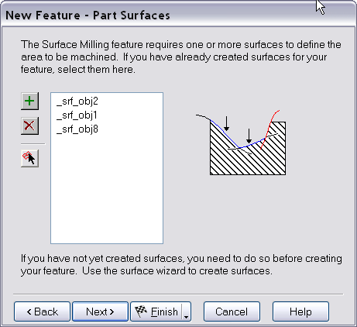
3D: User interface
Add surfaces to be machined in the feature
Tip: preselect the surfaces and then click on the green add button to add multiple surfaces to the list
Notes:
Show how to add multiple surfaces to the list.
Note that you can ‘pick’ surfaces to populate the list one by one or you can select multiple surfaces by holding crtl or by creating a selection window.
Preselecting surfaces will fill in the list automatically.

Slide 4
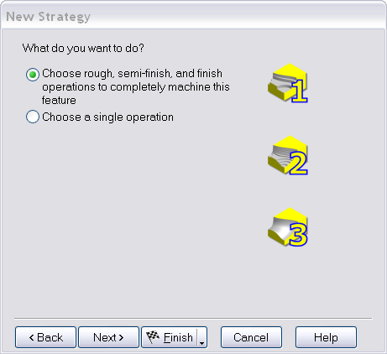
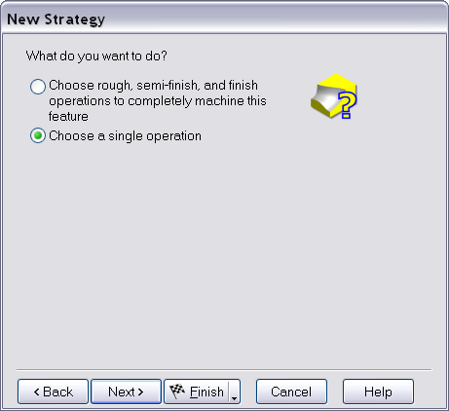
3D: User interface
Options
Notes:
New strategy
To complete this page:
Click Choose rough, semi-finish and finish operations to completely machine the feature to create multiple operations in one pass of the wizard.
Click Choose a single operation if you want to just make one operation.
Click Next
Let’s just select a single operation so we can discuss the available options:

Slide 5
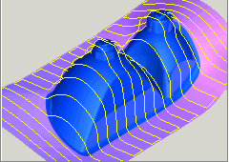
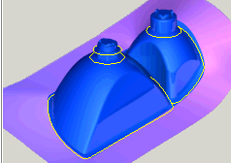
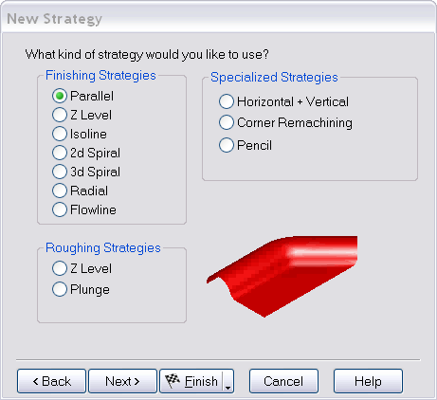
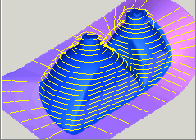
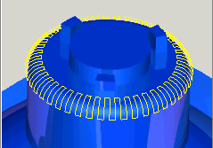
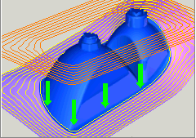
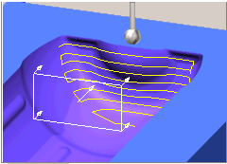
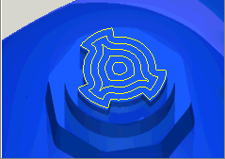
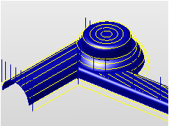
3D: User interface
Notes:
New feature new strategy
This page allows you to select the cutting strategy you want to use for your feature. You can only specify ***one and only one*** strategy in the New feature wizard. The strategy choices are grouped by finishing, roughing and specialized strategies. The strategy choices are divided into 3 different groups:
Finishing
Roughing
Specialized
*** click next to show one by one starting with roughing strategies***

Slide 6
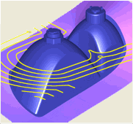
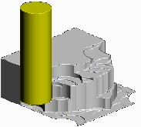
Roughing strategies
Z-level
Plunge milling

Slide 7
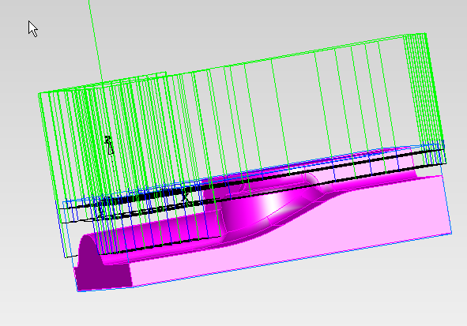
Roughing strategies
Z level
Z-level slices the feature
at various depths and mills
the corresponding 2½D
contours as a pocket or
boss shape at each depth
Zig-zag option = parallel
Notes:
Z level roughing slices the model at various depths to obtain planar contour curves. It then uses these curves to rough the model using a pocketing or boss toolpath generation technique. For a generalized boss, FeatureMILL3D uses the stock boundary or stock curve as the outer boundary of the boss.
There are two different methods of Z level roughing.
Zig-zag - more like an X parallel rough. Will rough each Z level raster-style with an optional profile pass around each slice.
Offsets - each slice is offset repeatedly to form the toolpaths.
Checking the reorder milling attribute for Z level rough will create a depth first strategy. Without Reorder checked, each Z level will be roughed completely before moving to a lower depth.

Slide 8
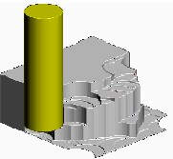
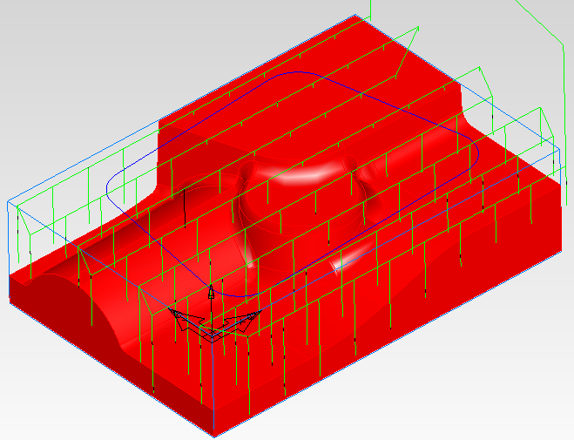
Roughing strategies
Plunge
With this technique,
roughing is performed with
a series of overlapping
holes
Parts can be roughed
quickly since the force of
the operation is directly up
the spindle.
Notes:
The pattern of the drilling operations are parallel to the X or Y axes just like parallel milling. Neighboring rows of the pattern can be offset horizontally to better cover the part.
Restrictions of plunge roughing
The initial implementation of plunge roughing is limited to center cutting tools. While you could use non-center cutting tools, nothing is done to specifically accommodate the use of such tools.
There is no control of the retract distance. Retracts are performed in the Z-direction.
There is no pecking. Each plunge is performed as a straight linear move.
The uphill only and downhill only settings do not apply.
Honeycomb pattern
Plunge roughing is performed in either a straight rectangular patter, shown below,
or a honeycomb pattern in which each row is offset horizontally by half the rough pass stepover amount.
The honeycomb pattern is usually preferable. The Honeycomb pattern strategy attribute controls the pattern type.

Slide 9
Finishing strategies
Parallel
Z-level
2D spiral
3D spiral
Isoline
Flowline
Radial

Slide 10
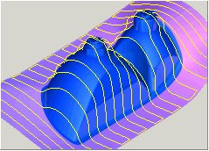
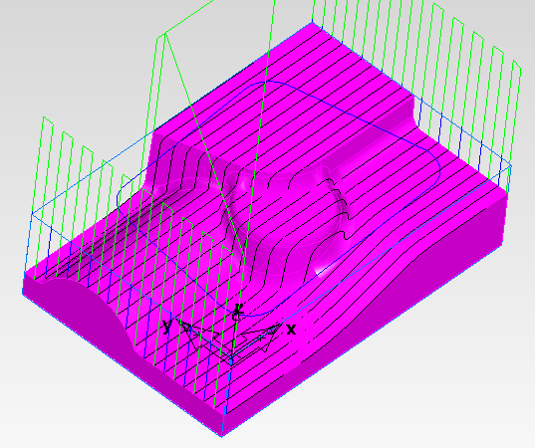
Finishing strategies
Parallel
Creates a raster pattern within a boundary and projects it onto the model.
X axis, Y axis and angle capabilities
Notes:
Parallel toolpaths
Parallel toolpaths are parallel to the X axis or Y axis of the current setup. For parallel milling, select X parallel to cut parallel to the X axis, Y parallel to cut parallel to the Y axis. Also specify an Angle (measured in degrees in the counter clock-wise direction) to rotate the toolpaths off of the principal axis.
To slant the toolpaths relative to the axis, set the Parallel angle attribute on the Strategy tab.
This method mills only the area above and down to the surface(s) in the feature. If part of the stock does not have a feature surface in it, that area won’t be milled away, except perhaps incidentally to the manufacturing of another surface feature. For parallel-like roughing, use a Z-rough with a zig-zag option to cut at multiple depths.
***Example: camera_cavity remach.fm
Show how the parallel toolpath goes across whole part. You want to motivate remachining.***
***Parallel Remachining
V12 (FC2006) had remachining too. It computed boundary curvees and restricted toolpaths to those regions. FC2007 works same way. Works with
z-level finish
parallel
3D spiral (this one is new) with constant scallop height everywhere***

Slide 11
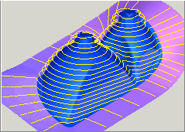
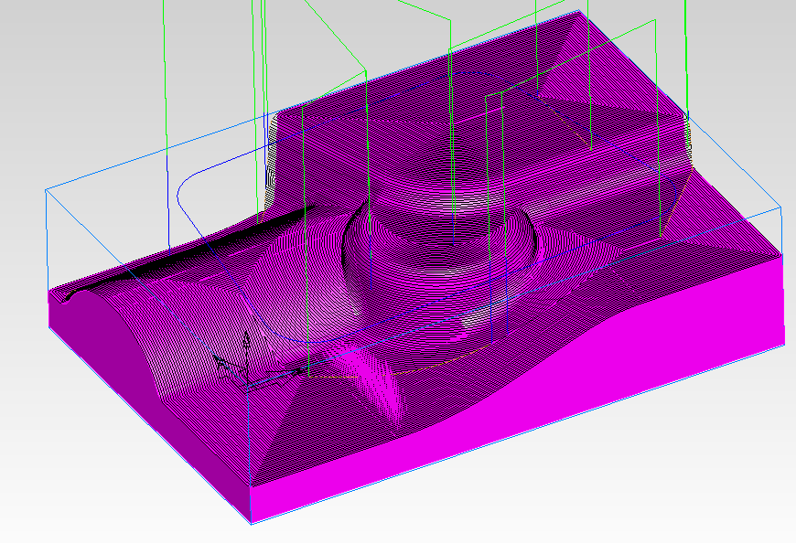
Finishing strategies
Z level
Creates a toolpath by
slicing the model at
specific Z heights
This technique works well
for steep sloped walls.
Interleave option
Notes:
Z-level finishing is a good technique for finishing steep walls or when you require a consistent depth of cut. This technique is sometimes called “waterline milling.” Just like Z level rough, it starts with slicing the model and then creating toolpaths from the slices.
Z level interleave option
The interleave option of Z level finishing inserts toolpaths in the shallow regions between the slices. This option attempts to finish the entire part with a minimum number of retracts.
Interleaved toolpaths are enabled by checking the interleave spiral paths checkbox on the strategy tab. Interleaved toolapths are controlled by the Spiral max slope parameter. This parameter controls the slope below which the zig-zag toolpaths are inserted. A higher setting of Spiral max slope will increase the size of the zig-zag or spiral region. In general, this parameter should be set to a value less than 40, since the zig-zag toolpaths should be limited to surfaces with slight slopes. When using the Interleaved technique, Z level toolpaths are always calculated using the desired scallop height, rather than an explicit Z increment. How accurately the toolapths fit the surfaces is controlled by the tolerance parameter. To minimize retracts, you may also have to adjust the stepover rapid distance. Arc-line approximation applies for the z level portion of interleaved toolpath.

Slide 12
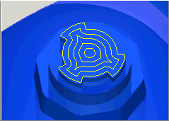
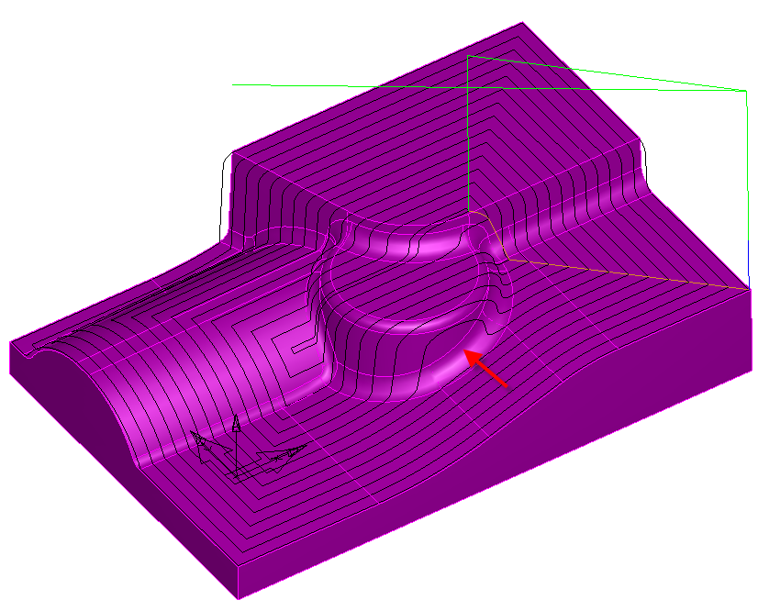
Finishing strategies
2D spiral
Continuous spiral either
towards the feature center
or away from the feature
center
General description of the
actual path as not all feature
shapes lend themselves to
a truly spiral pattern
Notes:
***2D
2D spiral projects straight down. Show a top-down view.
Has ability to go in and out. 3D doesn’t.
Only 2D has “open profiles” and “wall only” choices (boundaries page?)***
2D Spiral toolpaths mill a feature in a continuous spiral either towards the feature center or away from the feature center. Spiral is only a general description of the actual path as not all feature shapes lend themselves to a truly spiral pattern. The pattern is obtained by taking the stock boundary, the feature boundary or the curve specified in the Boundaries tab and offsetting this curve toward the center of the part. The steps between the passes is calculated in 2D. For spiral toolpaths that use a 3D stepover use the 3D spiral technique. To use the stock boundary, click Use stock dimensions as boundary on the Boundaries tab. This will result in a square shape to the toolpaths.
To automatically calculate the silhouette boundary of the surfaces of your feature, click Use part surfaces as boundary. This toolpath will mimic the boundary of your feature
If you want to use a different curve as your toolpath shape, click Use a curve as boundary on the Boundaries tab. The options for using a curve are different for spiral milling and other techniques.
*** show how 2D spiral would leave big scallop heights on the area where the arrow points. That area would be better machined with 3D spiral (next slide)***
Boundaries for 2D spiral toolpaths
The shape spiral toolpaths are determined by the boundary and island curves and the classifications of 3D pocket, 3D boss, 3D side, or Wall only Multiple boundary curves can be specified, but these curves must not touch. If none is specified, then the stock boundary will be used.
Curve allowance – The distance to stay away from the boundary or island curves. Note that for Wall only profile types, click the Other side button to offset the other direction. For bosses, use stock overcut % to control how close you come to approaching the stock boundary.
Total offset - This is the total distance away from the boundary curve to cut for boss or side profile types.
See also How to create a surface milling feature, Spiral toolpaths and How to create a 3D boss from font curves

Slide 13
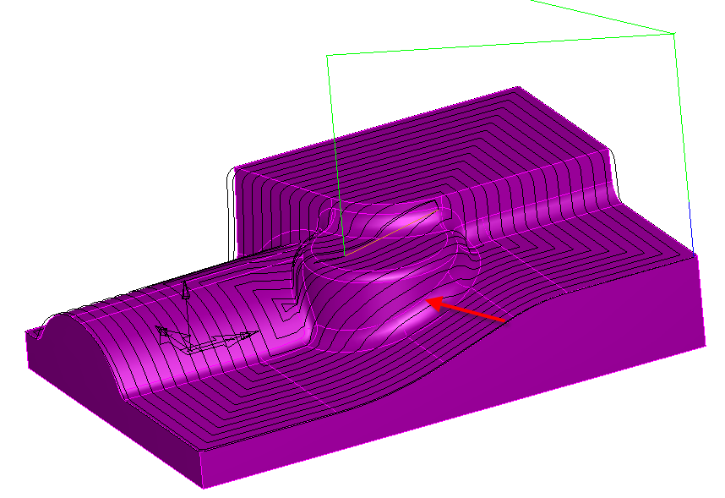
Finishing strategies
3D spiral
Creates a toolpath by
offsetting the model and
block
This technique is best suited
to machining areas which
require a constant stepover
and works well on near
vertical surfaces
Notes:
***show how FC created a constant stepover and machined the walls in several passes***
***3D 3D spiral is a type of stepover. Not really scallop height, but same effect. Steep surfaces get a nice stepover. 3D can do remachining. 2D can’t***
***Spiral Remachining
Show a corner of this op. it can now handle steep and shallow regions. We couldn’t do that before.***
On this PP you can see the tool not stepping over for each pass. That’s due to an option called ‘spiral’ which eliminates stepovers and creates a spial motion all over the part
Spiral toolpaths mill a feature in a series of offsets towards the feature center. The initial pattern is specified by taking the stock boundary, the feature boundary or the curve specified in the Boundaries tab. To use the stock boundary, click Use stock dimensions as boundary on the Boundaries tab. This will result in an initial square shape to the toolpaths. The next and subsequent toolpaths are obtained by offsetting the initial shape in 3d (along the surfaces being cut). This differs from 2d spiral operations which offset the initial shape in 2d and then project this shape onto the surfaces. Also, there is no spiral-out with a 3d spiral operation.
Select Use part surfaces as boundary in order to use the silhouette of the part surfaces as the initial boundary shape as shown in the simple figure on the left. The figure on the right shows the toolpaths that would result if Use stock dimensions as boundary were used instead.
The Spiral option on the milling attributes page will eliminate the stepover between the offsets, and morph the pattern into a continuous spiral. With the Spiral option checked you will get the result shown below. You can see that this minimizes the number of tool retracts and converts the original closed contours into one long spiral.
With the Spiral option un-checked you will get the following result. Notice that there is a retract between each contour.
The regions of the spiral can be controlled by specifying a slope angle on the Boundaries tab. In the example below, the slope angle is set to 30 degrees. Regions with slope greater than 30 degrees are avoided.
Boundary curves can also be used to control the shape of the spiral. All of these options are accessed by clicking the Curve options button on the Boundaries tab. By specifying a boundary curve, this shape is used as the initial contour of the spiral.
The boundary curve is clipped against part surfaces as shown in the figure below. If the curve is entirely outside of the stock, the silhouette of the surfaces is used as the boundary curve.
If the operation is specified as a boss, then boundary curves determine regions that will be avoided.
If the operation is specified as a pocket, then the boundary curves represent the shape of each region. Any island curves are avoided. In the example below, the operation is specified as a pocket with three boundary curves. The lower left region also has a circular island region.
Details of 3D spiral milling
The Z height of any boundary curve is ignored. This means that the curve can be above, below or even inside of the part.
The total offset option of the Boundary curve dialog is disabled for 3D spiral milling.
***Example: spiral 2D 3D.fm
Show how to add a new operation of each***

Slide 14
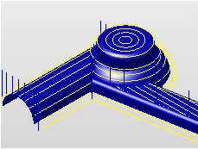
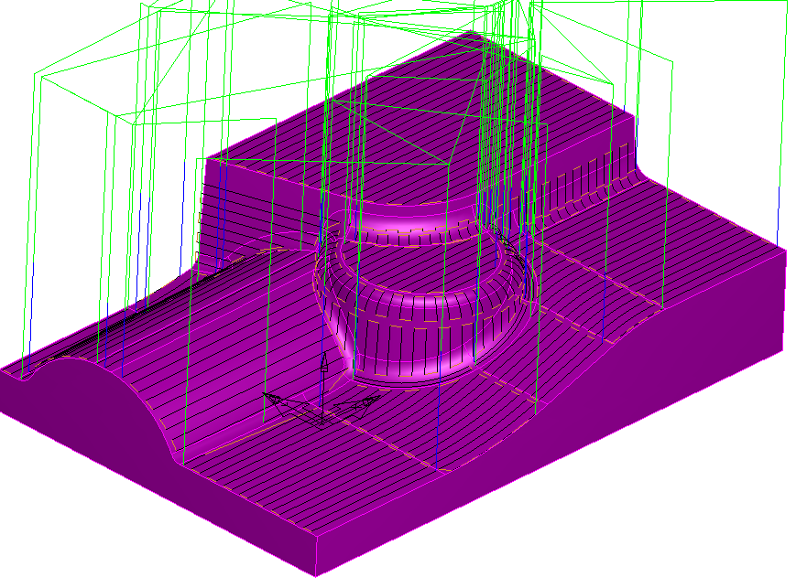
Finishing strategies
Isoline
This technique uses the
curves of a surface to mill
the surface.
Isoline milling works on a
surface by surface basis.
This can result in numerous
retracts
Undercutting technique
Notes:
Advantages
Uniform finish with scallop height control. The toolpaths are spaced based on the distance along the surface.
Nearly-vertical walls handled well. Since this is not a projection technique, nearly vertical walls are cut correctly.
Disadvantages
Toolpaths generated on a surface by surface basis.
Restrictions of isoline milling
Isoline milling works on a surface by surface basis. This can result in numerous retracts.
The orientation of the surfaces matters. Toolpaths are generated for surfaces whose normals point up. Surfaces are “auto flipped” where possible, but for vertical and some other cases, the machining side must be specified. Select the surface in the list box and click Switch machining side. Isoline milling may mill on the wrong side of the surface or if certain flags are set, it may skip the surface.

Slide 15
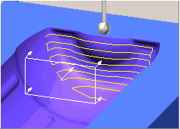
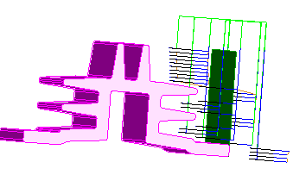
Finishing strategies
Flowline
Drive surface machining.
Projects the isolines from
one surface onto the
surfaces of the feature
The isolines are projected in
the direction of the surface
normal
Undercutting technique
Notes:
The Flowline technique projects the isolines from one surface onto the surfaces of the feature. The isolines are projected in the direction of the surface normal. In the example below, the isolines of a flat surface are projected onto the part. By using a side mill cutter, flowline machining can be used to machine undercut regions.
***Example: flowline bottle.fm***

Slide 16
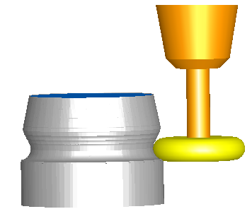
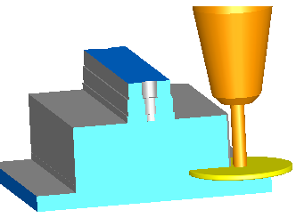
Finishing strategies
Undercutting isoline - flowline
To machine undercut regions
you must create an Isoline or
Flowline operation
Use a side mill cutter (only
available in operations
supporting undercuts)
Support for lollipop endmills
Notes:
Select an appropriate side mill cutter. FeatureCAM will not automatically select side mill cutters.
Specify a Horizontal lead-in/out plane on the leads tab. You may also have to experiment to determine an appropriate Ramp diameter to prevent gouging
***Example: undercut isoline.fm***

Slide 17
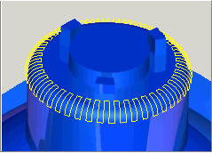
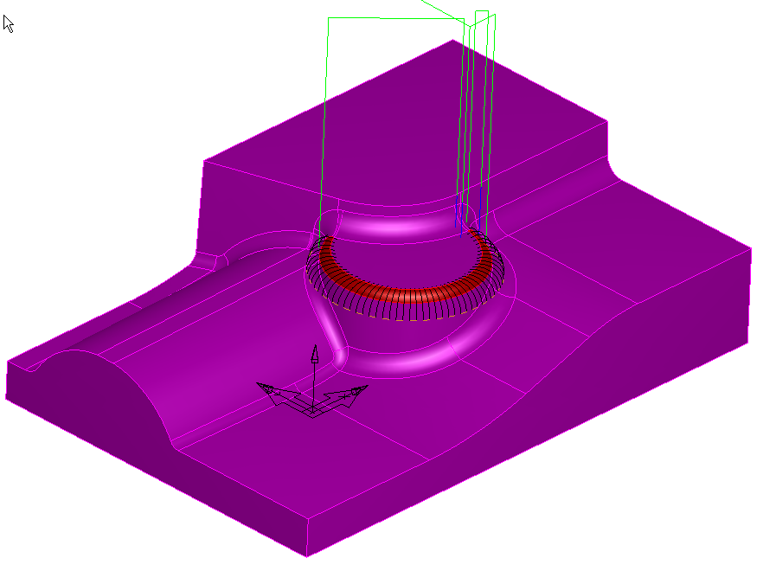
Finishing strategies
Radial
Creates a radial pattern
within a boundary and
projects it onto the model
Radial toolpaths are created
from the center of the part
toward the boundary
Notes:
The center of the pattern is automatically calculated unless the Center point milling attribute is set.
Not all feature shapes lend themselves to this manufacturing style. Features long in one direction and skinny in the other probably aren’t best milled in this way. The radial term is only a rough description of the actual path as not all feature shapes lend themselves to a truly radial pattern.

Slide 18
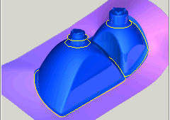
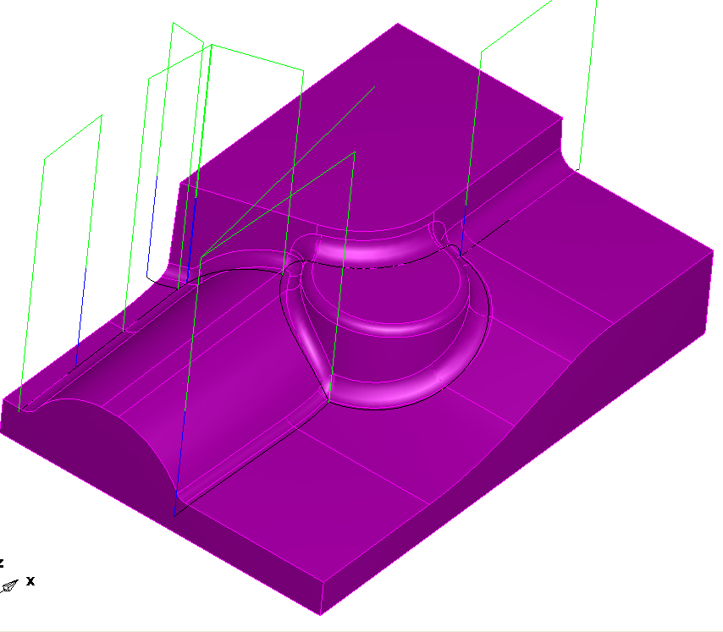
Specialized strategies
Pencil
Creates a single trace corner
toolpath
Used to clean up corners or
fillets of a part.
Automatically detect corners
less than or equal to the
specified radius and then
creates a single toolpath to
clean out these corners
Notes:
***Pencil Mill Remachining
Can’t reorder yet, but will be able to with toolpath editing. Pencil Milling
Flat Example: pencil flat.fm
We didn’t have horizontal only pencil milling in FC2006. Set horiz only to 0 deg to cut only flat surfaces. Set internal only to avoid wrapping around edge.
Multi-Pencil
Cuts from the outside in. Compute determining a center path and then offsetting it, stepping away from center. But it cuts from outside in.
This option cuts a wider path than along/across.***
Applications of pencil milling include:
Finishing fillets in a part with a single toolpath
Cleaning up sharp concave corners
Pre-relieving corners before high-speed finishing the part with a small tool
Roughing fillets by using the finish allowance.
The first step is to determine the regions that contain the corners as shown on the left. Depending on the number of surfaces in the model, this step may take a little time. After the regions are detected, a single toolpath is created that will clean out the corners regardless of the number of surfaces contained in the region.
what it means to have a pencil milling operation with the remachine checkbox checked??
This means "multi-pencil". Pencil… multi-pencil is the one where you can step in. Plain pencil finds one path. Multi-pencil cuts more, a little extra. It tens to do a better job connecting things into long loops. Corner remachining has a bunch of options. It finds all the fillets where the tool fits. It allows you to cut short way or long way. Corner remach breaks up the regions a little bit more. More retracting going on. Corner remach allows you to divide it into steep and shallow regions and change the toolpath on the steep parts. The multi-pencil will go up and down the fillet. Turn on the slope control by: using "combo along and across". Pencil has a slope value, but it chops off parts of the toolpath. The pencil slope value doesn't do the same thing as the corn-remach slope idea. With Multi-pencil, your final pass will be right down the fillet, exactly. With corner remaching your last pass might not be dead nuts on the fillet.

Slide 19
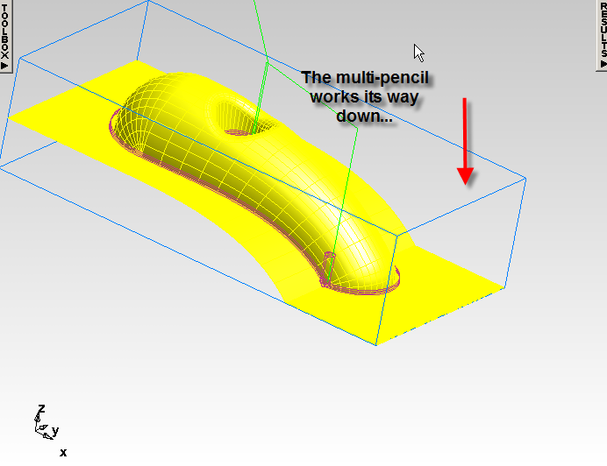
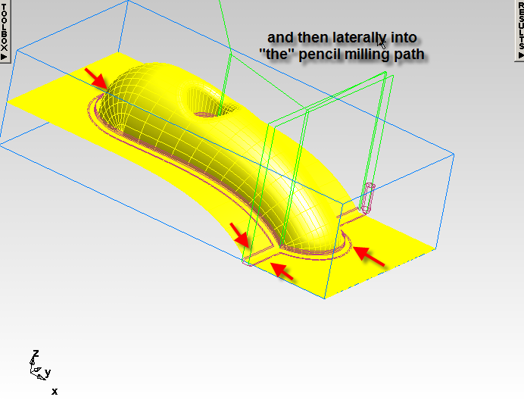
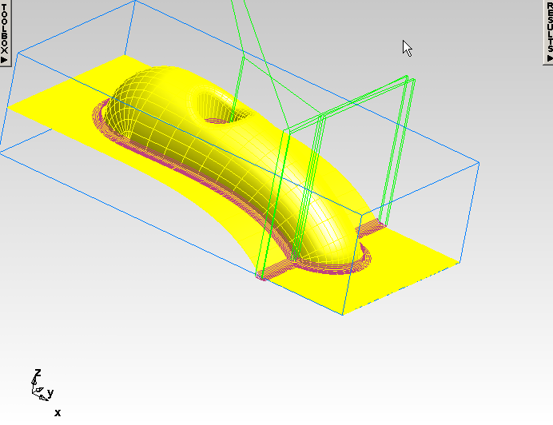
Pencil Milling
More robust
Multiple passes

Slide 20
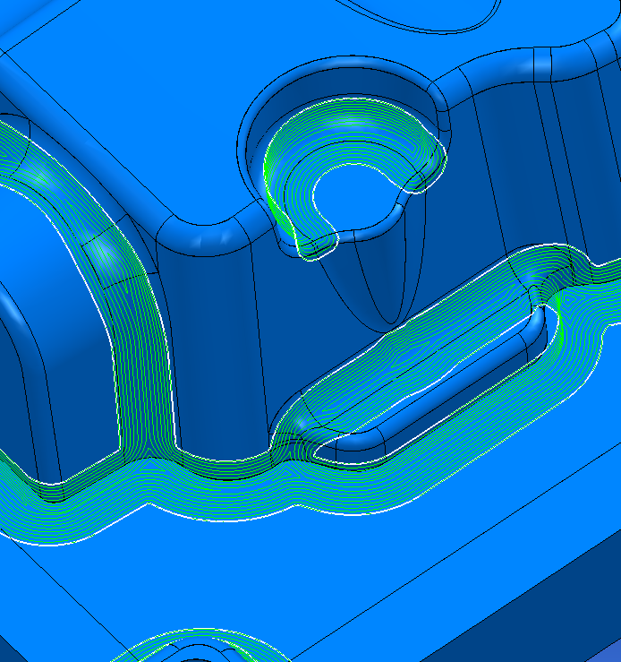
Corner Remachining
Applies to parallel, z-level, and 3D spiral
Can use flat-end tool

Slide 21
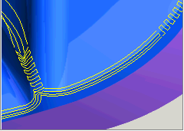
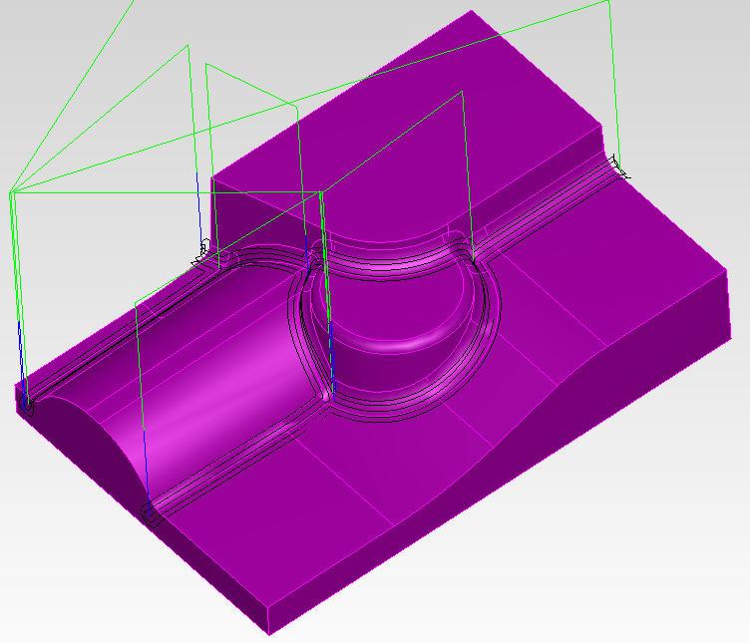
Specialized strategies
Corner remachining
Automatically mill regions that were
not cut by previous operations
Corner remachining is used to clean
up corners that occur between non
tangential surfaces
Corner remachining is available in
four different styles: along, across,
combo along and across and Multi
pencil
Notes:
***Corner Remachining
Example: corner remachining.fm
How is this different from remachining?
Show where it is on the add-operation page.
Show the options on the strategy page.***
Remachining is used to automatically mill regions that were not cut by previous operations. You provide the diameter of the previous tool that was used to cut the part and FeatureCAM automatically determines the uncut regions and applies a toolpath to them.
The tool used for the corner remachining must be smaller than the Previous tool diameter
Corner remachining is used to clean up corners that occur between non-tangential surfaces. Each "corner edge" is called a "trace line". By using the options on the strategy page, you may cut in various directions relative to the trace lines.
Corner remachining is available in four different styles: along, across, combo along and across and Multi pencil.
Along
This style of remachining creates a corner toolpath which will follow the trace lines.
Across
Across remachining creates corner toolpaths that zig-zag across the trace lines.
Combo Along and Across
The combo corner toolpath creates a corner toolpath which produces Across toolpaths on the steep areas of the trace line and Along toolpaths on the shallow areas of the trace line.
Multi-pencil
Creates a corner toolpath which will follow 'along' the trace lines. This is basically a different ordering of the 'along' tool path.
Note that the slope boundaries tab is available, so that a "horizontal-only" corner operation is possible.
Detection Limit - only corners below the angle specified will be found.

Slide 22
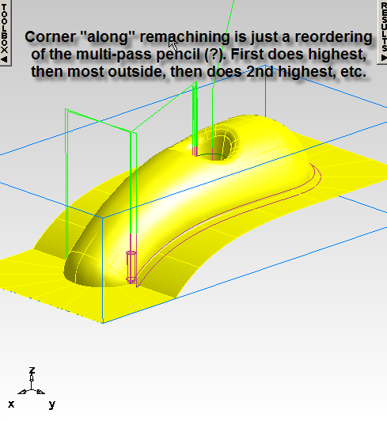
“Corner Along”

Slide 23
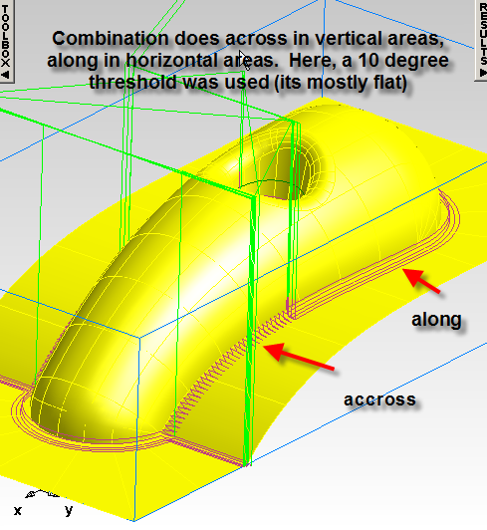
“Combination”

Slide 24
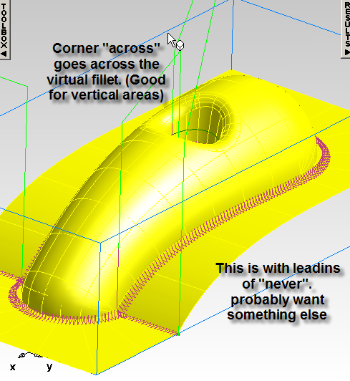
Corner Across

Slide 25
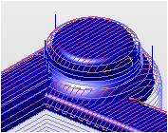
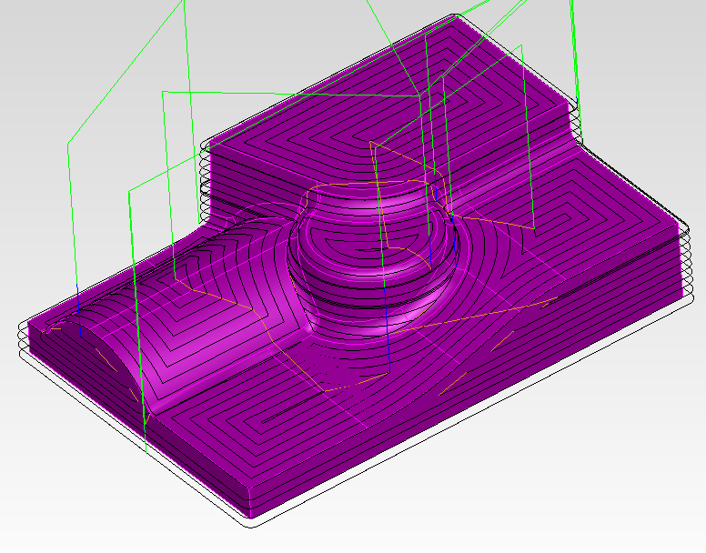
Specialized strategies
Horizontal + Vertical
This strategy combines two
different toolpath operations, one
for finishing shallow portions of
the part and a Z-level for finishing
the steep regions.
An X parallel or spiral toolpath is
applied to the shallow regions,
while a z level finishing operation
cuts the steep regions.
Notes:
The Slope boundary on the Strategy page indicates the angle that will divide the two regions. Portions of the surfaces with slopes less than this angle will be machined with the parallel toolpaths, and the steeper slopes are machined by the Z level. The Slope overlap indicates how much the two regions will overlap. An overlap of 0 means that the two regions will be distinct. A value of 10 means that the two passes will overlap by 10 degrees. The parallel pass will be parallel to the X axis unless the Parallel angle is set. Set the Parallel angle to 90 to be parallel to the Y axis. If you are using a spiral in or spiral out toolpath for the shallow regions, the shape of those regions will be automatically calculated based on the slope region boundaries.

Slide 26
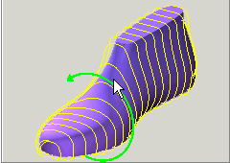
Specialized strategies
4 axis rotary
Creates a toolpath by rotating the
model around the index axis, with
linear motion provided by the
non-index axis coordinate pairs.
Rotary milling creates toolpaths
that cut surfaces without the need
for wrapping
Three options, circular, line or spiral
Notes:
Overview of Rotary
Creates a toolpath by rotating the job around the index axis. This axis is often the Z-axis in a millturn document and often the X-axis in a milling document. Rotary milling creates toolpaths that cut surfaces without the need for wrapping. In a millturn document, the feature must have the "Cut with X-tool" checkbox checked in the Feature Location tab before you can create a rotary operation. The angle of the X-tool must also be 0.
There are three options, circular, line or spiral, for the cutting style found on the strategy page.

Slide 27
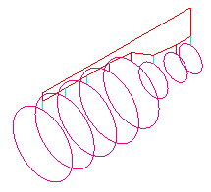
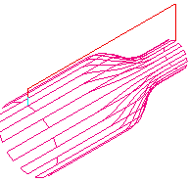
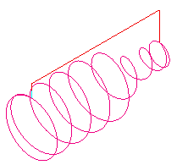
Specialized strategies
4 axis rotary
Circle Rotary Milling job rotates with the tool
at a fixed position, effectively machining a
circle. The tool then steps over the required
amount and machines the next circle.
Line Rotary Milling tool will traverse along the
index axis in straight lines, with the rotary axis
only used at the end of each pass to reposition
the job.
Spiral Rotary Milling continuous spiral is cut
along the length of the job when spiral milling
is used. To ensure a
clean finish a full circle is cut at the two ends.

Slide 28


Boundaries
This page allows you to limit the extent
of the toolpaths.
Use part surfaces as boundary: create toolpaths on the surfaces regardless of the location of the stock.
Use stock dimensions as boundary: restrict the toolpaths to the portions of the surface feature that are within the stock.
Use a curve as the boundary: to use curve(s) to restrict the toolpath boundaries or to affect the shape of a spiral toolpath
Notes:
Click Use part surfaces as boundary to create toolpaths on the surfaces regardless of the location of the stock. If you are using a spiral toolpath, this option automatically calculates the silhouette curve of the feature and uses this curve as the shape of the spiral. This generally has the best shape for spiral toolpaths.
Click Use stock dimensions as boundary to restrict the toolpaths to the portions of the surface feature that are within the stock. If you are using a spiral toolpath, this option uses the outline of the stock as the shape of the spiral.
If you want to use curve(s) to restrict the toolpath boundaries or to affect the shape of a spiral toolpath, click Use a curve as the boundary. Additional options are displayed for 2D spiral toolpaths, 3D spiral toolpaths or all other techniques.
If you are using a spiral operation that is limited by slope, then you will usually want to check Use slope region boundary for spiral operation. Using this option, the shape of the spiral operations is based on the outlines of the slope-based regions.

Slide 29


Process tab
Shows the operations that are
included for milling the
feature have checks set in their
checkboxes in the operations list
This allows you to customize
operations and then turn them
off to reduce screen clutter when
working on subsequent
operations.
Notes:
3D Process tab overview
The Process tab shows the operations that are included for milling the feature have checks set in their checkboxes in the operations list. You can turn off operations by unchecking them. This allows you to customize operations and then turn them off to reduce screen clutter when working on subsequent operations.
The buttons on the right have these functions:
Add new operation
This page allows you to select the cutting strategy you want to use for your feature. You can only specify one strategy in the New feature wizard. The strategy choices are grouped by finishing, roughing and specialized strategies.
Delete operation
Delete operation discards an operation from the feature. You can disable an operation instead by unchecking the operation. The checkbox, when set, includes that operation in the feature.
Move operation up
Move operation up changes the order of operations in the milling feature by moving the selected operation up one place in the feature.

Slide 30

Controlling lead moves
Controls how the tool moves on
and off the surface milling feature
(lead in/out) and how the tool
moves between toolpaths
(stepovers)

Slide 31



Controlling lead moves
Stepovers type
Direct: The tool
moves straight over
to the next position.
The tool can move in
all 3 axes
Stair step: The tool moves up in Z and then over in X and Y
Loop: The tool makes an arc move out of one toolpath and an arc move into the next toolpath.
Notes:
Stepover type
The Stepover type controls the type of transition move that is inserted between toolpaths. The choices are:
Direct: The tool moves straight over to the next position. The tool can move in all 3 axes. This figure shows a direct stepover move on a flat surface feature.
Arc: For Z-roughing only, the tool attempts to connect to the next position with an arc. (If that is not possible, an arc and several tangential lines are used). For Z-roughing, only Direct and Arc apply.
Stair step: The tool moves up in Z and then over in X and Y. This figure shows a stair step transition move on a spherical surface.
This figure shows the same surface feature using a direct stepover.
Loop: The tool makes an arc move out of one toolpath and an arc move into the next toolpath. These transitions are actually programmed from linear moves and may move all three axes. This figure shows a loop move on a flat surface feature.

Slide 32

Controlling lead moves
Ramping (rough only)
If Ramp to depth is not
checked, the tool will plunge
to depth.
If Ramp to depth is checked
and Helical is not checked,
the tool will zig-zag into the
material. The angle of the
zig-zag passes is controlled
by Ramp angle.
If helical is checked the tool
will spiral into the material

Slide 33

Controlling lead moves
Lead in – out
The Use lead in/out drop-down
list controls when lead moves
will be applied. The options
are:
Never
On all plunges/retract
On first plunge/retract
On all toolpaths
Notes:
The Use lead in/out drop-down list controls when lead moves will be applied. The options are:
Never: Do not use lead moves on this feature.
On all plunges/retract: Apply the leads on all plunge and retract moves.
On first plunge/retract: Apply on the first plunge and first retract move only.
On all toolpaths: Apply the leads on every toolpath.

Slide 34


Controlling lead moves
Lead in – out
The arcs and ramps are measured relative to one of the following options
Normal
Horizontal
Vertical
Default
Notes:
Normal: Lead in/out moves are relative to the surface normal.
Horizontal: Moves are relative to a horizontal plane. Directions of the ramp could be right or left.
Horizontal left: This setting is most useful for uni-directional paths. It ensures a consistent left ramping.
Horizontal right: This setting is most useful for uni-directional paths. It ensures a consistent right ramping.
Vertical: Moves are relative to a vertical plane.
Default: The default for z level finish is horizontal, and vertical for all others.

Slide 35

Controlling lead moves
Use arc ramp in/out
Ramp diameter: The
diameter of the ramp
move
Ramp in angle: The angle
of the ramp in move
Ramp out angle: The
angle of the ramp out
move
Notes:
Use arc ramp in/out
If Use arc ramp in/out is selected the following parameters are used to control the ramping on and off the part feature:
Ramp diameter: The diameter of the ramp move.
Ramp in angle: The angle of the ramp in move.
Ramp out angle: The angle of the ramp out move.

Slide 36

Controlling lead moves
Use linear lead in/out
Lead-in angle: Angle
measured away from the
toolpath for the lead-in move
Lead-out angle: Angle
measured away from the
toolpath for the lead-out move
Lead-in length: Length of the
linear lead-in length
Lead-out angle: Length of the
linear lead-out length
Notes:
Use linear lead in/out
If Use linear lead in/out is clicked then the following parameters controls the move off of the feature:
Lead-in angle: Angle measured away from the toolpath for the lead-in move. Note this angle can be negative.
Lead-out angle: Angle measured away from the toolpath for the lead-out move. This angle can be negative.
Lead-in length: Length of the linear lead-in length.
Lead-out angle: Length of the linear lead-out length.

Slide 37

Miscellaneous attributes
Direction
Checkboxes
Not all checkboxes are
available for all
operation types.
Bi-directional sets the operation to mill in each direction. You can combine this setting with Climb Mill to force the first pass to be a Climb mill cut.
Climb Mill sets the operation to use climb milling. When set in conjunction with Bi-directional milling, it ensures that the first pass will climb mill.

Slide 38
Miscellaneous attributes
Arc/line approximation
Click this checkbox to create an
arc line approximation for
toolpaths that are contained in
the XY, YZ and XZ planes.
This allows 3D programs to be
smaller and to result in smoother
surface finishes for certain types
of parts.
Notes:
Arc/line approx.
Click this checkbox to create an arc line approximation for toolpaths that are contained in the XY, YZ and XZ planes. This allows 3D programs to be smaller and to result in smoother surface finishes for certain types of parts.
Arc/line approximation applies to the following 3D techniques
X-parallel and Y-parallel roughing or finishing with Parallel Angle set to 0
Z-level finishing
Iso-line finishing where the toolpaths line in a plane
Note that there is no arc/line approximation attribute for Z level rough. Arc/line approximation is always performed on Z-level roughing passes.

Slide 39


Miscellaneous attributes
Scallop Height
Toggles the way that
you specify how far
the tool moves over
between passes
Stepover
Scallop height
Notes:
Scallop height checkbox
This checkbox is available on the Milling page of certain finish operations. For projection milling methods, it toggles the way that you specify how far the tool moves over between passes. With Scallop height unchecked, you specify the stepover. With it checked, you specify the scallop height.
For Z-level finish operations it toggles how you specify how the tools moves down in Z. With Scallop height unchecked, you specify the Z-increment. With it checked, you specify the scallop height.
With scallop height checked, spacing of the toolpaths are calculated along the surfaces to provide a uniform surface finish. These figures show surfaces cut without using scallop height,
This figure shows the same surfaces cut with scallop height.

Slide 40

Miscellaneous attributes
Reorder
It tells FeatureCAM
to resequence the
toolpaths to
minimize retractions
while trying to avoid
full width cuts.
Notes:
Reorder
The reorder attribute tells FeatureCAM to resequence the toolpaths to minimize retractions while trying to avoid full width cuts. Use Reorder when you have a part where several separate regions are cut. If you want the toolpaths to move directly across a surface without worrying about retractions, turn off Reorder.
For Z-level operations (rough or finish), the Reorder attribute will enable zone machining, where the toolpaths will descend in the Z (or –Z) direction if that is more efficient than cutting the entire part in complete Z levels. The phone handset example below shows that the toolpaths will cut the top of the part in complete Z levels and then cut one side and the other.

Slide 41


Miscellaneous attributes
Spiral
With the Spiral milling
attribute checked, the
toolpaths change into a
continuous spiral. The
toolpaths no longer
have a constant Z
height
Notes:
Spiral Z level
The standard Z level finishing toolpaths creates paths with a constant Z height as shown below. The tool either retracts or feeds along the surface between Z levels.
Spiral Z level
The standard Z level finishing toolpaths creates paths with a constant Z height as shown below. The tool either retracts or feeds along the surface between Z levels.
With the Spiral milling attribute checked, the toolpaths change into a continuous spiral. The toolpaths no longer have a constant Z height.

Slide 42


High Speed Machining
Defines the type of corner
correction that you want to apply
to all internal corners of a Z level
finish toolpath. The types are
available from a pull-down list and
three options are available:
None - no sharpening or arc
fitting is carried out.
Arc fitted - arcs are created
in all internal corners.
Notes:
Corner Correction
Corner Correction defines the type of corner correction that you want to apply to all internal corners of a Z-level finish toolpath. The types are available from a pull-down list and three options are available:
None - no sharpening or arc fitting is carried out.
Arc Fitted - arcs are created in all internal corners.
None
By default sharpening is carried out on all internal corners. The yellow toolpath shows the sharpened toolpath and the green toolpath shows the Normal toolpath.
Arc fitted
Internal corners are rounded with an arc.
The yellow toolpath shows the Arc Fitted toolpath and the green toolpath shows the Normal toolpath.
Arc fitting is of particular importance when high speed machining as it eliminates sudden changes in tool direction.
Corner Correction Arc Radius
This defines the radius used if you select a Type of Arc Fitted. The radius is defined as a proportion of the tool diameter. The default value is 0.05. So, if you have a tool of diameter 10mm (radius 5mm) then the arc radius will be 0.5mm. The Arc Radius can have a value between 0 and 0.2.

Slide 43

High Speed Machining
Work into tight areas using trochoids

Slide 44

High Speed Machining
Inserts trochoids more liberally than v12

Slide 45
Selecting Solids
Right-click on a face and choose Select Solid

Slide 46

Tooling
Flat-end, bullnose and tapered tools are now available for 3D operations
T-slot and lollipop cutters supported for undercuts

Slide 47
End of 3D training class
Questions?
Notes:
Corner Correction
Corner Correction defines the type of corner correction that you want to apply to all internal corners of a Z-level finish toolpath. The types are available from a pull-down list and three options are available:
None - no sharpening or arc fitting is carried out.
Arc Fitted - arcs are created in all internal corners.
None
By default sharpening is carried out on all internal corners. The yellow toolpath shows the sharpened toolpath and the green toolpath shows the Normal toolpath.
Arc fitted
Internal corners are rounded with an arc.
The yellow toolpath shows the Arc Fitted toolpath and the green toolpath shows the Normal toolpath.
Arc fitting is of particular importance when high speed machining as it eliminates sudden changes in tool direction.
Corner Correction Arc Radius
This defines the radius used if you select a Type of Arc Fitted. The radius is defined as a proportion of the tool diameter. The default value is 0.05. So, if you have a tool of diameter 10mm (radius 5mm) then the arc radius will be 0.5mm. The Arc Radius can have a value between 0 and 0.2.

